Slide 1
Clustering for Scaling Applications
https://nodejs.org/api/cluster.html

Slide 2
Deployment - Challenges in Node
How to handle crashing of application server to provide reliability and availability?
How to make application scalable?
How to give maximum performance inspite of single thread model?
How to add security layer and provide authentication, authorization, integrity and confidentiality?

Slide 3
Scaling applications
As Node.js runs in a single thread mode but it uses an event-driven paradigm to handle concurrency.
It also facilitates creation of child processes to leverage parallel processing on multi-core CPU based systems.
Server listens on port 3000 shared by 4 node processes on Quadra core machine with node clustering so that even one process is faulted, others will take care with internal load balancing (Code which does this magic).
This offers scalability (Solve C10K/C1M/C5M problems)

Slide 4
Scaling applications
Different Load balancers
Clustering (Built-in load balancer in Node )
Nginix (Load balancer – good for static files)
HAProxy (High Availability Proxy) – Load balancer
Varnish (Caching proxy)

Slide 5
Scaling applications
Node provides child_process module which has following three ways to create child process.
exec - child_process.exec method runs a command in a shell/console and buffers the output.
spawn - child_process.spawn launches a new process with a given command
fork - The child_process.fork method is a special case of the spawn() to create child processes.

Slide 6
Scaling node

Slide 7
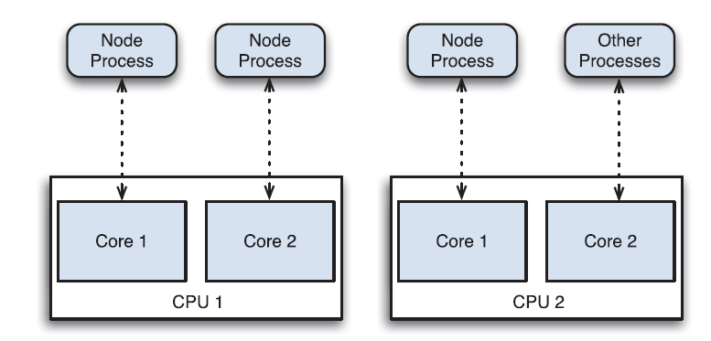
Deployment - Challenges in Node
Level 3 : Multiprocessor Deployment :Using the Proxy
run one node process per core

Slide 8
Deployment - Challenges in Node
The problem now faced with is that n Node processes running, all of which must listen on a different port.
(You can’t have multiple people listening on the same port number.)
How do you get traffic to mydomain:80 to these servers?
solve this problem by implementing a simple round-robin load balancer that is given a list of node servers running particular web application.
Redirect incoming requests to domain to these other servers, one at a time.

Slide 9
Deployment - Challenges in Node
To implement the load balancer, first compile a list of servers.
A server with four cores- give three of them over to the app (and leave the fourth for running other system services).
Run these app servers on ports 8081, 8082, and 8083.

Slide 10
Deployment - Challenges in Node
Now List of servers is
{ "servers": [ {
"host": "localhost",
"port": "8081"
}, {
"host": "localhost",
"port": "8082"
}, {
"host": "localhost",
"port": "8083"
} ] }

Slide 11
Deployment - Challenges in Node
Http server now:
var http = require('http');
if (process.argv.length != 3) {
console.log("Need a port number");
process.exit(-1);
}
var s = http.createServer( function (req, res) {
res.end("I listened on port " + process.argv[2]);
});
s.listen(process.argv[2]);

Slide 12
Deployment - Challenges in Node
Launch three servers on UNIX/Mac platforms by typing
$ node app.js 8081 &
$ node app.js 8082 &
$ node app.js 8083 &
On Windows platforms, launch them by running the following three commands in different command prompts:
node app.js 8081
node app.js 8082
node app.js 8083

Slide 13
Deployment - Challenges in Node
now build proxy server using the npm module http-proxy . The package.json looks
{
"name": "Round-Robin-Demo",
"description": "A little proxy server to round-robin requests",
"version": "0.0.1",
"private": true,
"dependencies": {
"http-proxy": "0.8.x"
} }
Proxy maintains an array of available servers and then for each request coming to the service, cycles through those available servers and forwards on the requests to them.

Slide 14
Deployment - Challenges in Node
var httpProxy = require('http-proxy'),
fs = require('fs');
var servers = JSON.parse(fs.readFileSync('server_list.json')).servers;
var s = httpProxy.createServer( function (req, res, proxy) {
var target = servers.shift(); // 1. Remove first server
proxy.proxyRequest(req, res, target);
// 2. Re-route to that server
servers.push(target); // 3. Add back to end of list
});
s.listen(8080);

Slide 15
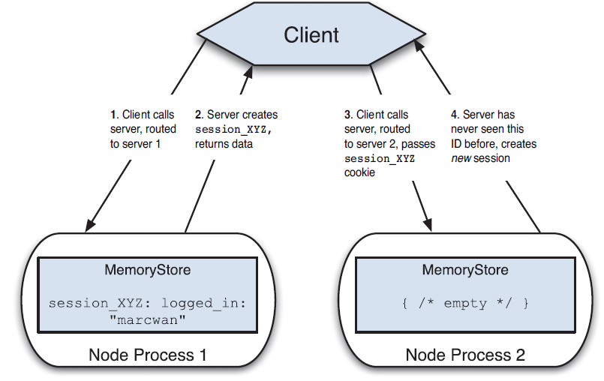
Deployment - Challenges in Node
Multiple instances of server and session data

Slide 16
Deployment - Challenges in Node
Solution : memcached
To install it as a service, you then run
c:\memcached\memcached -d install
You can then run the memcached service by typing
>net start memcached

Slide 17
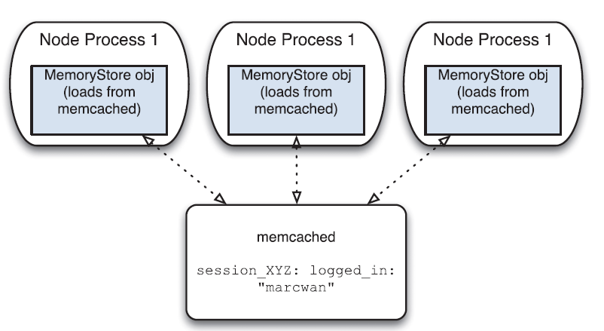
Deployment - Challenges in Node
It listens on port 11211
murthysri

Slide 18
memcache with express
in package.json: "connect-memcached": “latest“ and install
var express = require('express');
var MemcachedStore = require('connect-memcached')( express );
var mcds = new MemcachedStore({ hosts: "localhost:11211" });
var app = express()
.use(express.logger('dev'))
.use(express.cookieParser())
.use(express.session({ secret: "cat on keyboard",
cookie: { maxAge: 1800000 },
store: mcds }))
.use(function(req, res){
var x = req.session.last_access;
req.session.last_access = new Date();
res.end("You last asked for this page at: " + x);
})
.listen(8080);

Slide 19
Clustering

Slide 20
Clustering
Each Node.js process runs in a single thread and by default it has a memory limit of 512MB on 32-bit systems and 1GB on 64-bit systems.
Although the memory limit can be bumped to 1GB on 32-bit systems and 1.7GB on 64-bit systems, both memory and processing power can still become bottlenecks for various processes.

Slide 21
Clustering
The solution Node.js provides for scaling up the applications is to split a single process into multiple processes or workers.
This can be achieved through a cluster module.
The cluster module allows to create child processes (workers), which share all the server ports with the main Node process (master).

Slide 22
Clustering
Node.js Cluster Module: what it is and how it works
A cluster is a pool of similar workers running under a parent (Master) Node process.
Workers are spawned using the fork() method of the child_processes module.
This means workers can share server handles and use IPC (Inter-process communication) to communicate with the parent Node process.

Slide 23
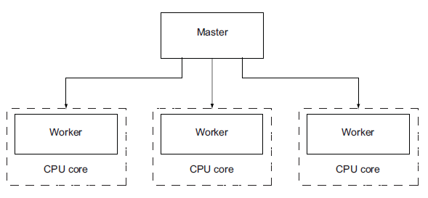
Clustering
A master spawning
three workers on a
four-core processor
cluster API makes it easy for application to simultaneously run multiple “workers” on different cores that each do the same thing and respond to the same TCP/IP port.

Slide 24
Clustering
The master process is in charge of initiating workers and controlling them.
We can create an arbitrary number of workers in master process.
By default incoming connections are distributed in a round-robin approach among workers .

Slide 25
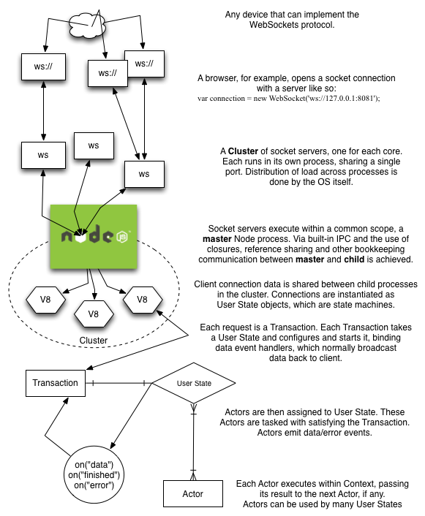

Slide 26
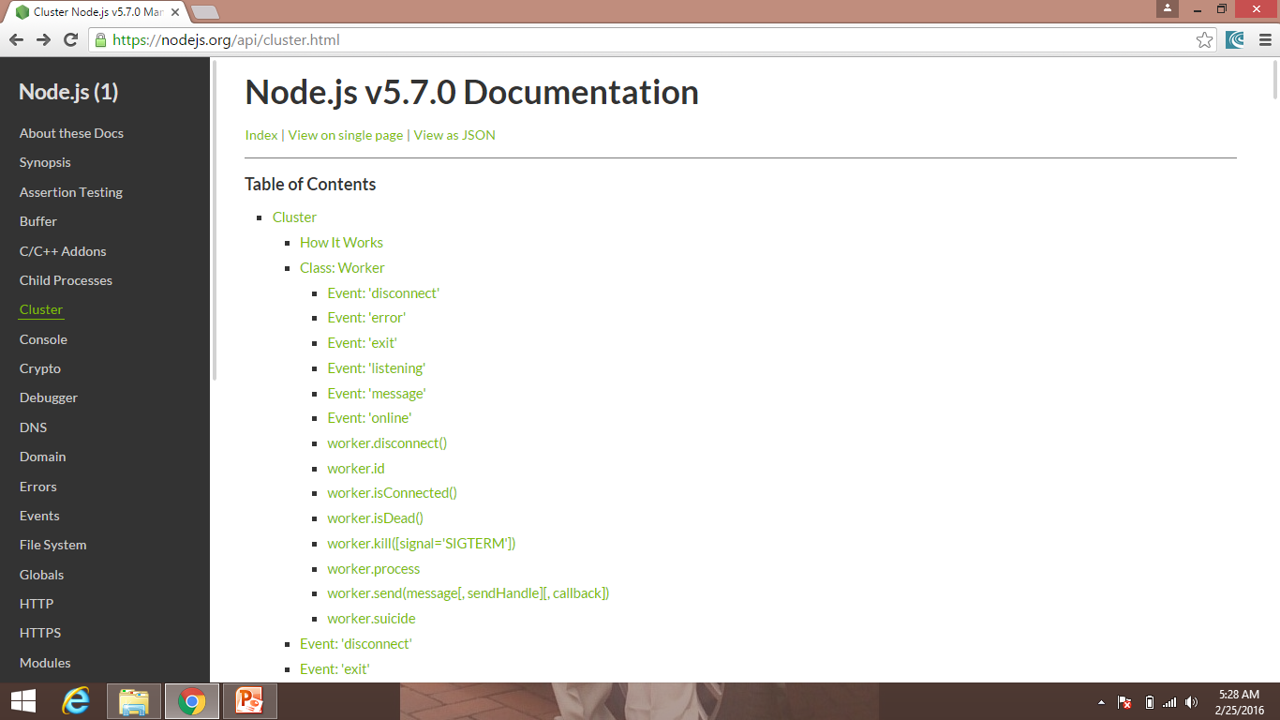
Clustering

Slide 27
Clustering
var cluster = require('cluster);
A cluster module executes the same Node.js process multiple times.
To identify which is master, use below code
if(cluster.isMaster) { ... }
The master process is the process we initiate, which in turn initialize the workers.
To start a worker process inside a master process, use the fork() method:
cluster.fork();

Slide 28
Clustering
A cluster module contains several events.
Two common events related to the moments of start and termination of workers are the online and the exit events.
online is emitted when the worker is forked and sends the online message.
exit is emitted when a worker process dies.

Slide 29
Clustering
Steps :
Create a package.json and run npm install
"name": "express-cluster",
"version": "1.0.0",
"dependencies": {
"express": "^4"
}
}

Slide 30
Clustering
Create app.js and write code , (run now , node app.js)
// Include Express
var express = require('express');
// Create a new Express application
var app = express();
// Add a basic route – index page
app.get('/', function (req, res) {
res.send('Hello Cluster world!');
});
// Bind to a port
app.listen(3000);
console.log('Application running on port 3000!');
console.log('Worker running!')

Slide 31
Clustering
Now add cluster
// Include the cluster module
var cluster = require('cluster');
// Code to run if we're in the master process
if (cluster.isMaster) {
...
// Code to run if we're in a worker process
} else {
// Include Express
var express = require('express');
….
….
}

Slide 32
Clustering
Now add cluster
// Code to run if we're in the master process
if (cluster.isMaster) {
// Count the machine's CPUs
var cpuCount = require('os').cpus().length;
// Create a worker for each CPU
for (var i = 0; i < cpuCount; i += 1) {
cluster.fork();
}
// Code to run if we're in a worker process
} else {
...}
If your machine has four CPUs then cluster.fork will be called four times, creating four new processes.

Slide 33
Clustering
In case one of our worker processes dies, we’ll want to make sure we spawn another; otherwise we could eventually end up just running an empty master process and losing all our requests!
...
// Listen for dying workers
cluster.on('exit', function (worker) {
// Replace the dead worker,
// we're not sentimental
console.log('Worker %d died :(', worker.id);
cluster.fork();
});
...

Slide 34
Clustering
Benchmark testing with siege (Download it)
Without Clustering:
$ siege -c100 -t1M http://localhost:3000/
#> Transactions: 263 hits
#> Availability: 100.00 %
#> Elapsed time: 59.50 secs
#> Data transferred: 849.99 MB
#> Response time: 19.41 secs
#> Transaction rate: 4.42 trans/sec
#> Throughput: 14.29 MB/sec
#> Concurrency: 85.79
#> Successful transactions: 263
#> Failed transactions: 0
#> Longest transaction: 34.57
#> Shortest transaction: 10.07

Slide 35
Clustering
Benchmark testing with siege (Download it)
With Clustering
$ siege -c100 -t1M http://localhost:3000/
#> Transactions: 811 hits
#> Availability: 100.00 %
#> Elapsed time: 59.25 secs
#> Data transferred: 2621.08 MB
#> Response time: 6.50 secs
#> Transaction rate: 13.69 trans/sec
#> Throughput: 44.24 MB/sec
#> Concurrency: 88.96
#> Successful transactions: 811
#> Failed transactions: 0
#> Longest transaction: 16.47
#> Shortest transaction: 0.54

Slide 36
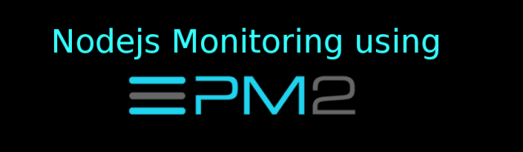

Slide 37
Nodejs monitoring using PM2
PM2 is a process manager for Nodejs application.
It comes up with its own load balancer.
It make sure that Nodejs application is fully available to end-user by reloading them in case of exception.
Steps :
npm install -g pm2
Create package.json (npm init –y)

Slide 38
Nodejs monitoring using PM2
{ "name": "pm2demo", "version": "1.0.0", "description": "", "main": "app.js", "scripts": { "test": "echo \"Error: no test specified\" && exit 1" }, "author": “Murthy", "license": "" }

Slide 39
Nodejs monitoring using PM2
Next - install express:
npm install --save express
Create app.js:
var express = require('express'); var app = express(); var router = express.Router(); router.get('/',function(req,res) { res.send("Hello Cluster world"); }); app.use('/',router); app.listen(3000);

Slide 40
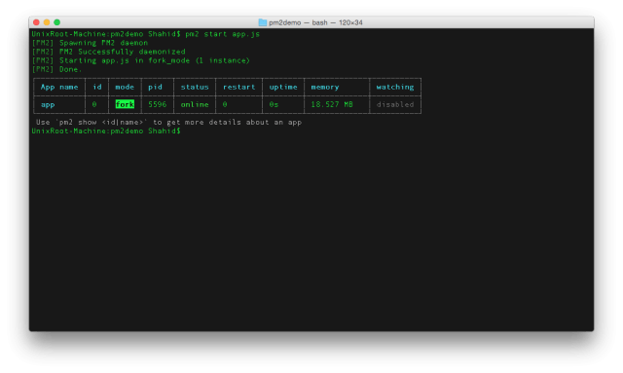
Nodejs monitoring using PM2
Pm2:\>pm2 start app.js

Slide 41
Nodejs monitoring using PM2
check the status of the app every time:
pm2:\> pm2 status
Visit localhost:3000 to view the app.
Now if your app crashes due to any issue, PM2 will restart it automatically.
In order to stop the app you can run following command.
pm2:/> pm2 stop <app name>
pm2:\> pm2 stop all (to stop all processes)
pm2:\> pm2 kill (to stop pm2 iteself)

Slide 42
Nodejs monitoring using PM2
To monitor the process live :
pm2:/> pm2 monit
This feed will update live as application keeps running and used

Slide 43
Keymetrics
Integrating PM2 with Keymetrics
Keymetrics is a web platform to monitor node application using PM2.
Visit below site and signup for new account:
https://keymetrics.io/
Once you sign up, create a new Bucket.

Slide 44
Keymetrics
A Bucket is like a container on which multiple servers and multiple apps can be attached to.
It's very convenient when you need to monitor a bunch of apps that belongs to the same companies or environment .
Each Bucket has a public and private key. This will allow PM2 to interact with a determined Bucket and most importantly, to communicate in a fully secured manner (with AES256).
After this, Keymetrics will provide the URL by which we can link app to Keymetrics.

Slide 45
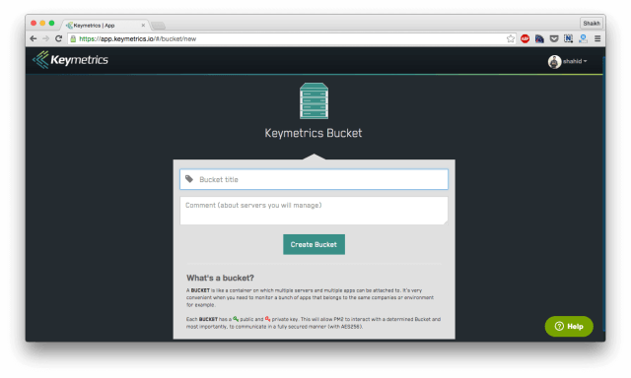
Keymetrics

Slide 46
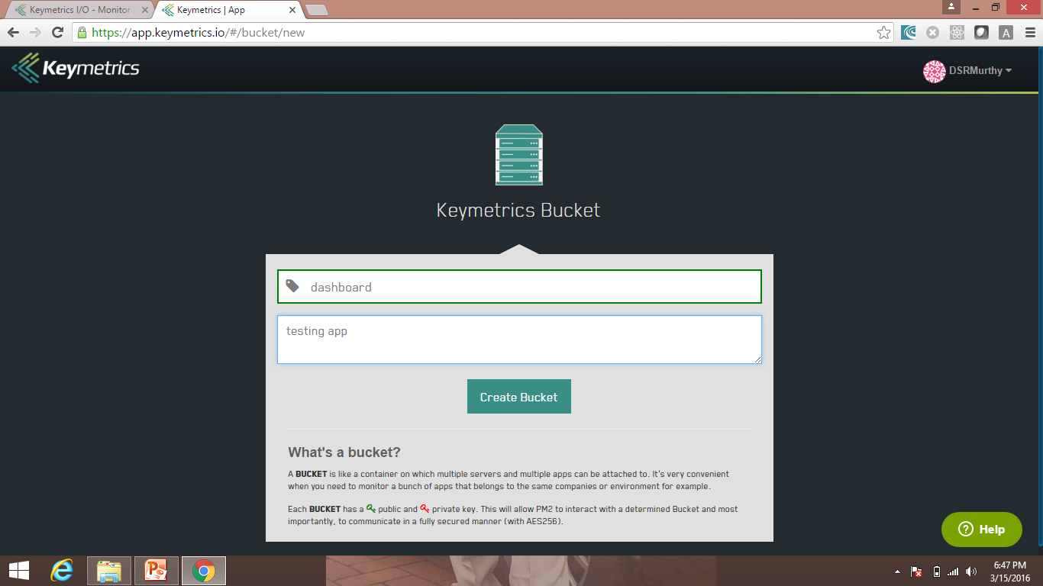
Keymetrics

Slide 47
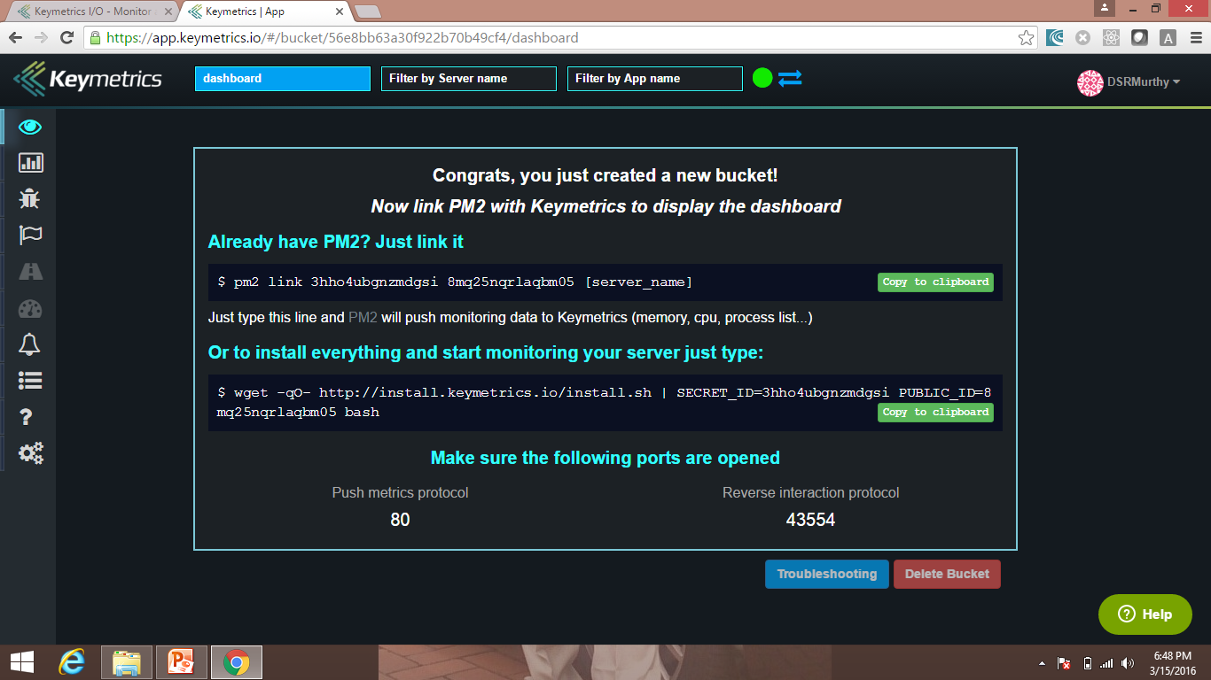
Keymetrics

Slide 48
Keymetrics
Already have PM2? Just link it
$ pm2 link 3hho4ubgnzmdgsi 8mq25nqrlaqbm05 [server_name]
Just type this line and PM2 will push monitoring data to Keymetrics (memory, cpu, process list...)
Or to install everything and start monitoring your server just type:
$ wget -qO- http://install.keymetrics.io/install.sh | SECRET_ID=3hho4ubgnzmdgsi PUBLIC_ID=8mq25nqrlaqbm05 bash

Slide 49
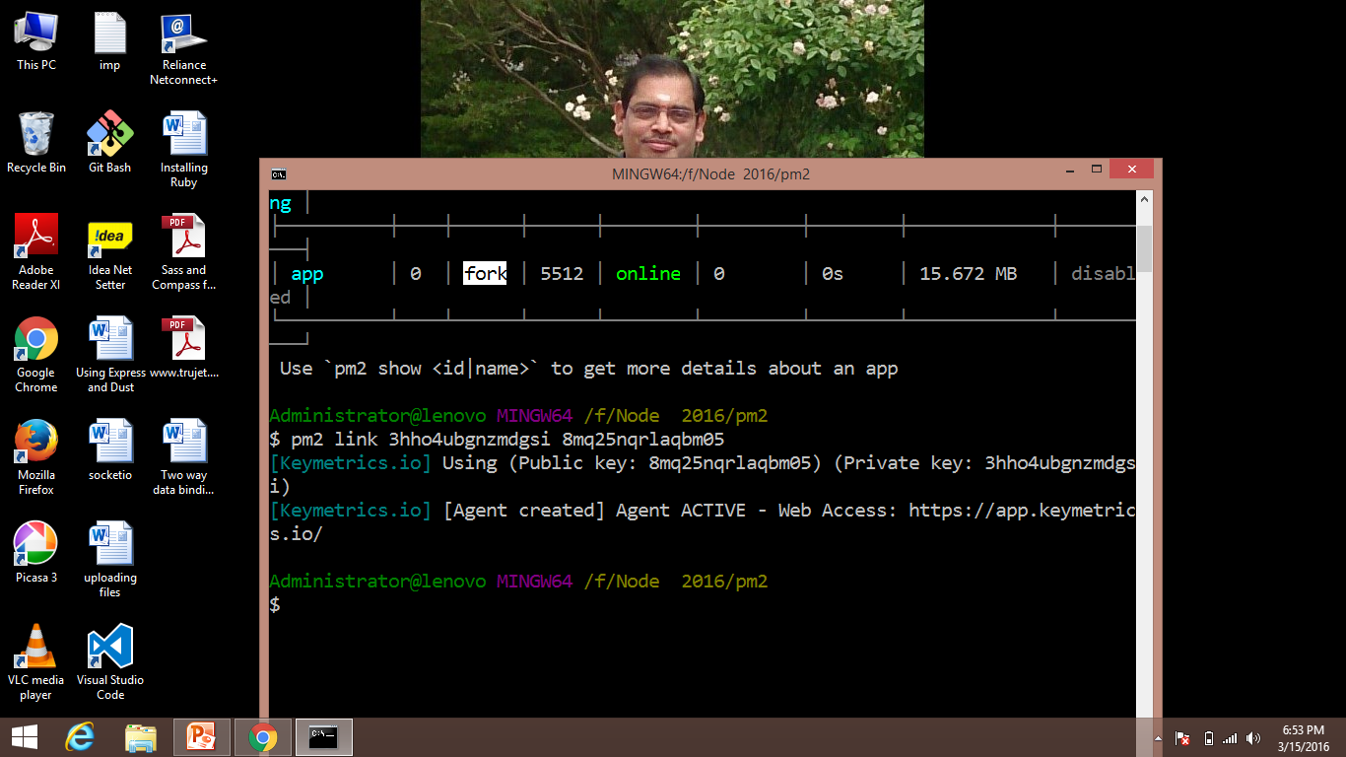
Keymetrics
Just copy the command and paste it in your terminal.

Slide 50
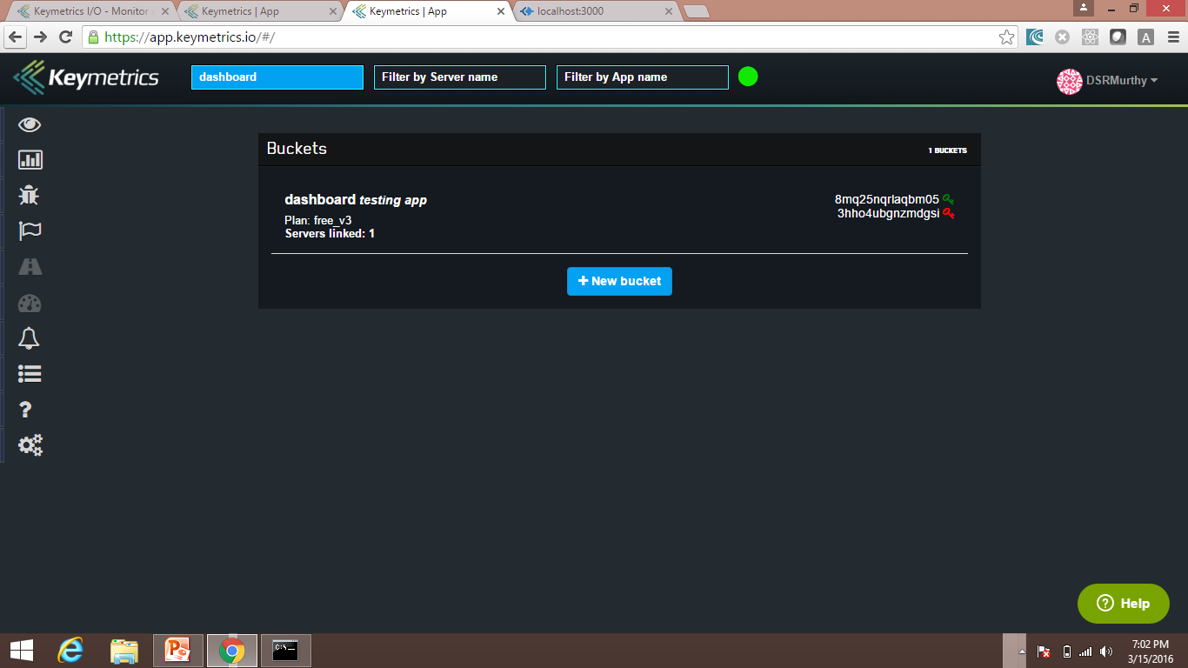
Keymetrics
Click here to monitor

Slide 51
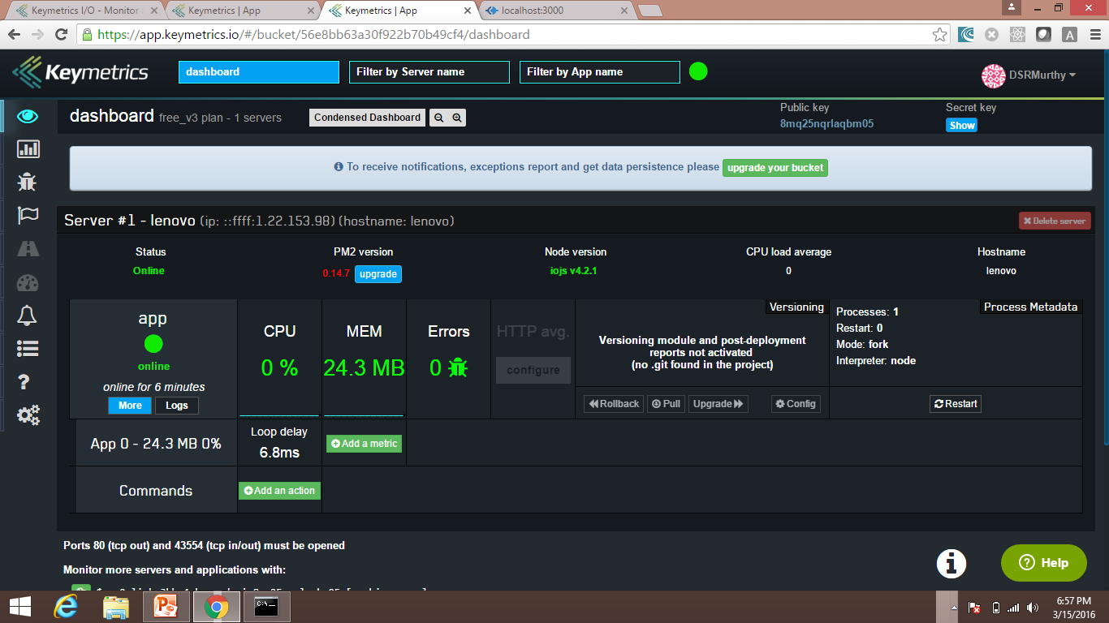
Keymetrics

Slide 52
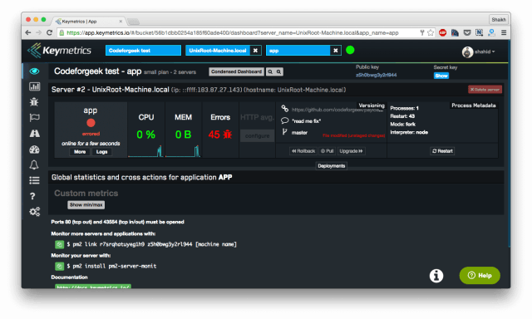
Keymetrics provides
CPU and Memory usage
In the main dashboard to visualize the amount of memory and CPU our app is consuming.
This data is also live and can see the comparative graph as well.

Slide 53
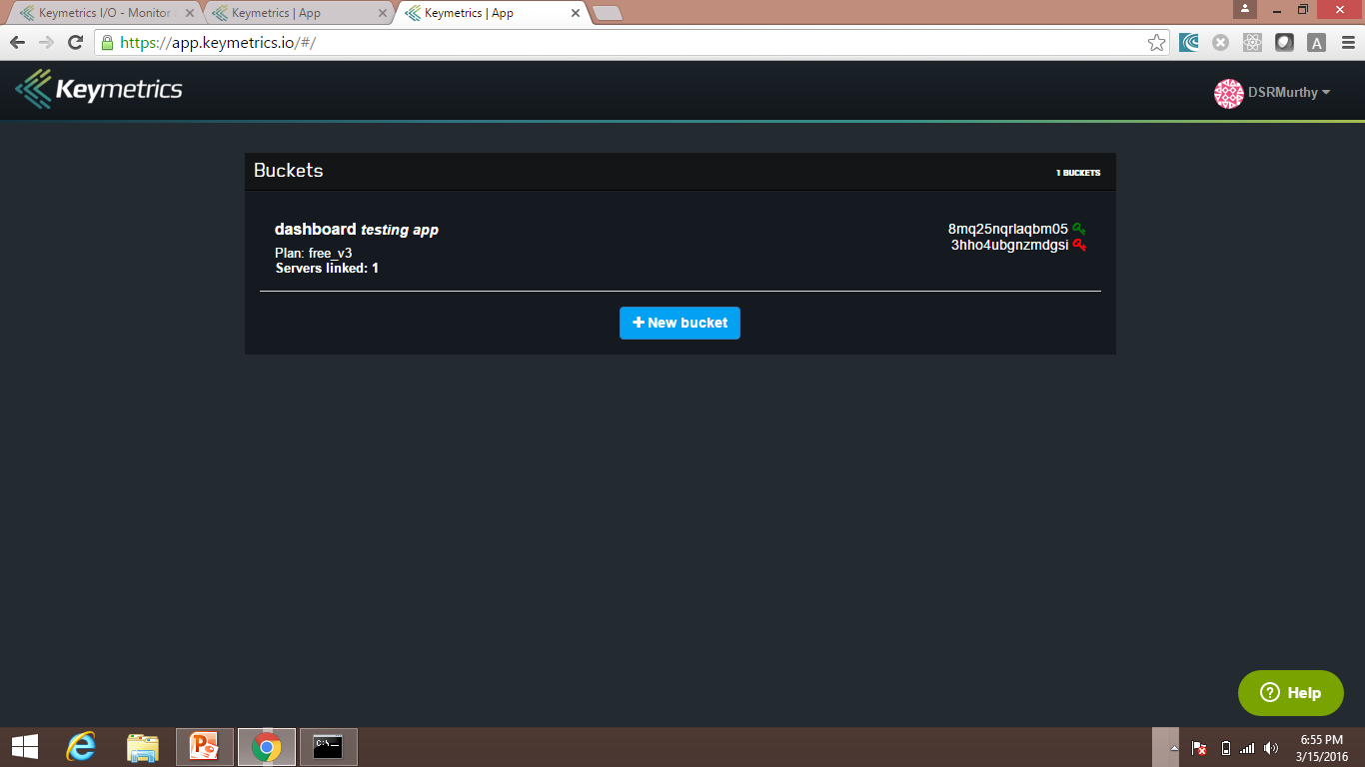
Keymetrics provides
Open browser and type $ pm2 link https://app.keymetrics.io

Slide 54
Keymetrics provides
Exception reporting
In case your application crashes due to some exception, PM2 will report it to keymetrics and keymetrics will immediately send email to your account and will show the exception detail in dashboard.

Slide 55
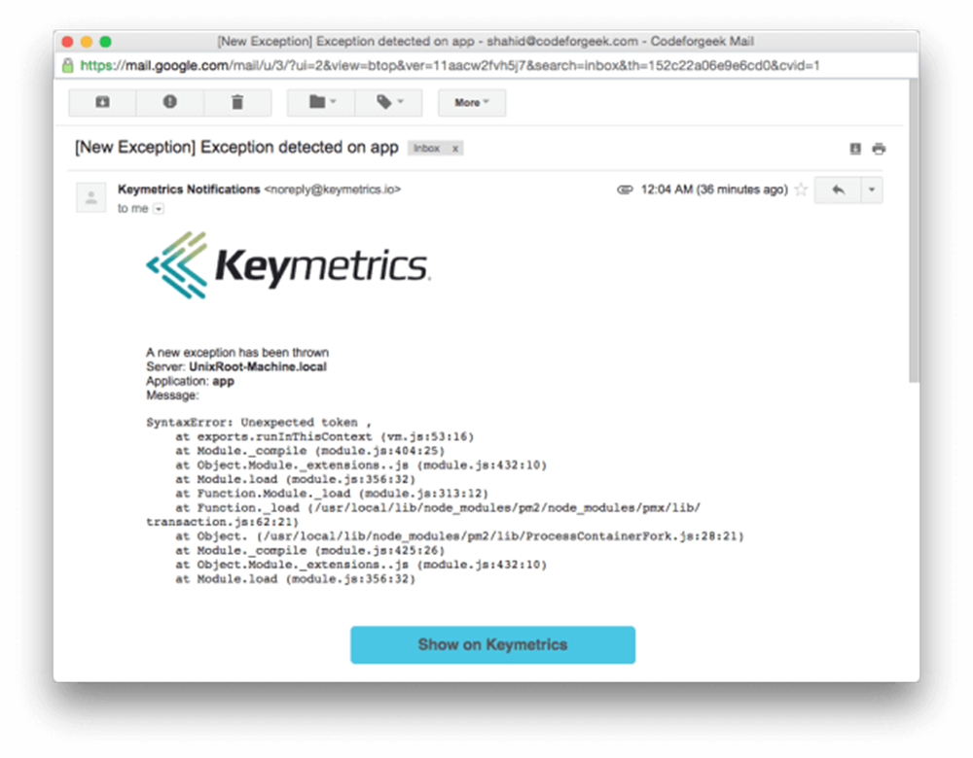
Keymetrics provides
Do syntax error in app.js and obsever below screen:
router.get('/',,function(req,res) { res.send("Hello World"); });
// put extra comma in route
>pm2 restart app.js
pm2 restart app.js

Slide 56
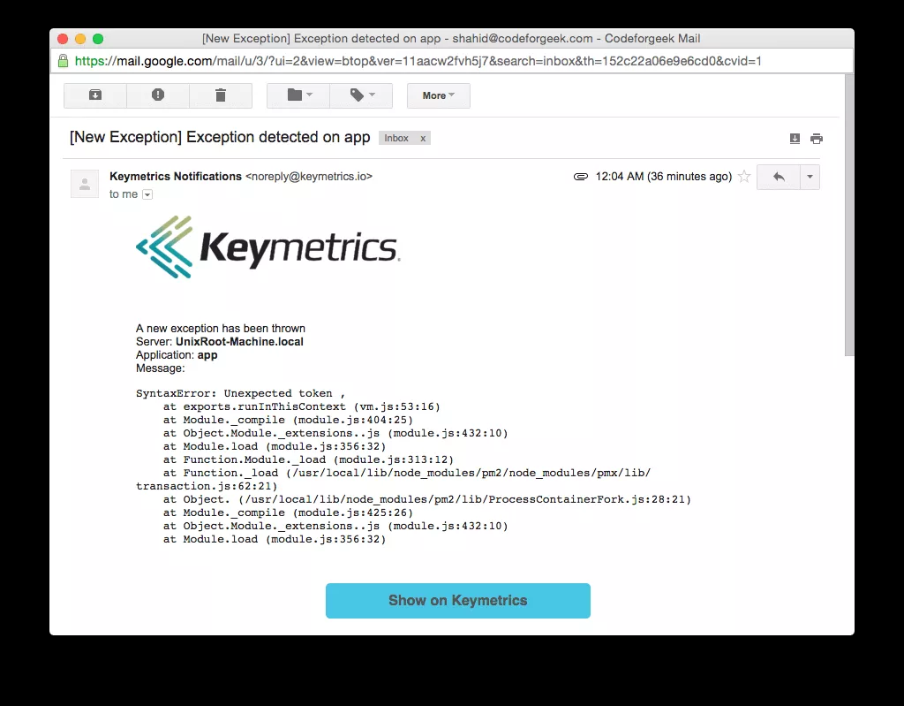
Keymetrics provides
Hit the route using by visiting localhost:3000 and you should receive an email immediately like this.pm2 restart app.js

Slide 57
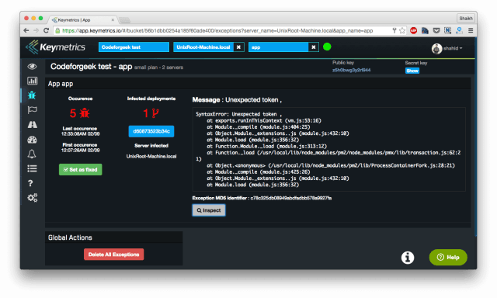
Keymetrics- Also see exception in dashboard

